Slide 1
Overview slides
April 2024

Slide 2


Datasets
Hosted portals
103,568
20
Country Participants
63
Peer-review papers
using data
10,393
Organizational Participants
Average records
downloaded per month (2024)
43
202.7 billion
Species
occurrence records
Publishers
2,202
2,690,679,082
By the numbers | 1 April 2024
www.gbif.org

Slide 3
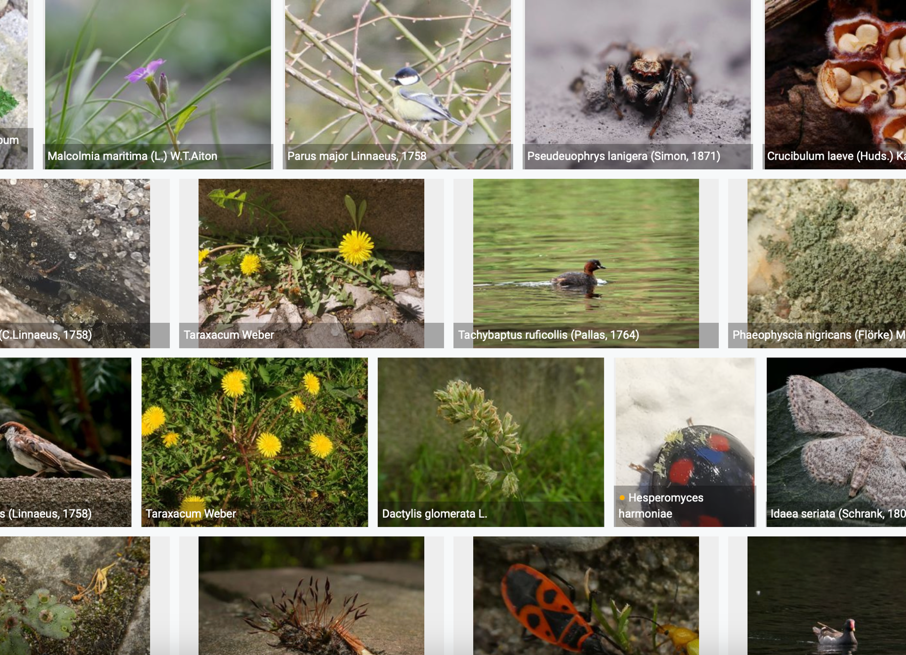
Species occurrence records with multimedia evidence
1 April 2024
166.6 million records with taxonomically identified images
110.2 million human observations
51.2 million specimens
2.8 million material samples
1.4 million fossil specimens
1,329,424 audio files
8,553 videos
https://www.gbif.org/occurrence/gallery

Slide 4
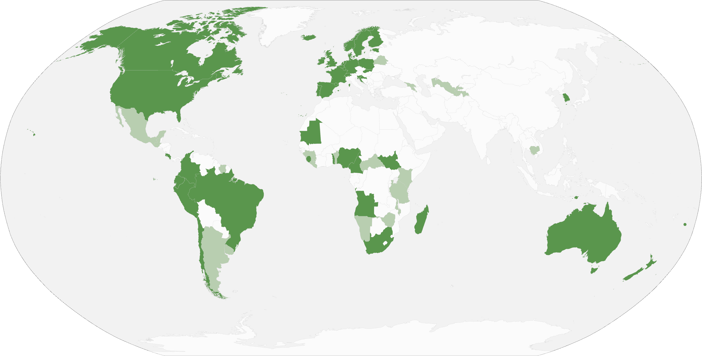
GBIF Participant countries
1 April 2024
Voting Participants
Associate Participants

Slide 5
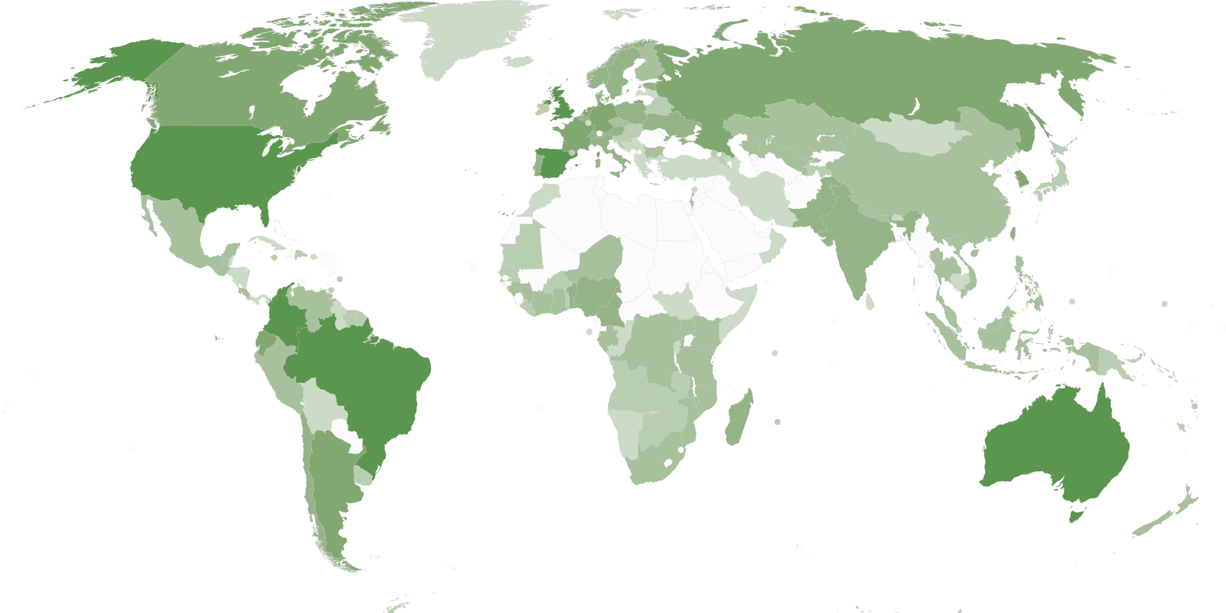
GBIF network of data publishing institutions
1 April 2024
142
countries/areas with institutions
sharing data through GBIF
Number of active publishers by country or area

Slide 6
GBIF.org traffic by country: 2024
1 April 2024
Rank | Country/Territory | Visitors | Visits | Effective visits* | % Effective visits | 2023 rank | Pages / visit
1 | United States | 174,335 | 207,858 | 93,536 | 9.85% | 1 | 4.72
2 | China | 172,517 | 290,283 | 52,251 | 5.50% | 7 | 2.94
3 | Colombia | 85,066 | 110,356 | 51,867 | 5.46% | 2 | 4.52
4 | Brazil | 97,668 | 112,610 | 48,422 | 5.10% | 3 | 3.87
5 | Spain | 68,357 | 88,259 | 45,895 | 4.84% | 8 | 6.67
6 | France | 86,639 | 105,000 | 45,150 | 4.76% | 6 | 4.30
7 | Mexico | 78,625 | 94,031 | 40,433 | 4.26% | 4 | 4.84
8 | Indonesia | 54,138 | 66,804 | 38,078 | 4.01% | 5 | 5.94
9 | Germany | 61,028 | 76,017 | 36,488 | 3.84% | 9 | 5.82
10 | India | 74,324 | 82,419 | 30,495 | 3.21% | 10 | 3.56
10 | United Kingdom | 47,015 | 60,949 | 30,475 | 3.21% | 11 | 6.14%
 | TOTAL | 1,727,146 | 2,207,413 | 949,188 | 100.00% |  | 4.85

Slide 7
Occurrences published by country: 2024
1 April 2024
Rank | Country/Territory | 2024 | 2023 total | 2023 rank
1 | France | 41,972,113 | 13,208,845 | 5
2 | United States | 6,251,578 | 151,004,708 | 1
3 | Netherlands | 3,926,163 | 14,293,849 | 4
4 | Japan | 2,091,220 | 900,859 | 31
5 | Sweden | 1,909,996 | 9,339,841 | 6
6 | Spain | 1,041,119 | 7,633,366 | 8
7 | United Kingdom | 1,005,380 | 36,220,446 | 2
8 | Denmark | 924,656 | 3,870,362 | 15
9 | Canada | 681,911 | 22,744,659 | 3
10 | Bulgaria | 576,189 | 217,015 | 66
OTHER COUNTRIES + AREAS | OTHER COUNTRIES + AREAS | 4,371,930 | 81,266,325
TOTAL |  | 64,752,255 | 355,993,458

Slide 8
Data download requests by country: 2024
1 April 2024
Rank | Country |  | 2024 | 2023 total | 2023 rank
1 | China | 12,590 |  | 39,253 | 1
2 | United States | 11,029 |  | 34,275 | 2
3 | Mexico | 7,99a |  | 26,051 | 3
4 | Brazil | 4,759 |  | 18,370 | 5
5 | Colombia | 4,278 |  | 19,341 | 4
6 | United Kingdom | 3,741 |  | 10,044 | 7
7 | Spain | 3,158 |  | 13,492 | 6
8 | Canada | 2,717 |  | 6,649 | 9
9 | France | 2,601 |  | 7,248 | 8
10 | Belgium | 1,950 |  | 3,094 | 18
OTHER COUNTRIES + AREAS | ALL OTHERS | 27,969 |  | 87,262
TOTAL |  | 82,783 |  | 267,773
130
countries, islands & territories where users have ≥5 requested downloads

Slide 9
Peer-reviewed publications using GBIF-mediated data
31 March 2024
Notes:
The next 3 slides are showcasing PPT standard or Live charts.
To create a chart simply click on the Insert tap on the ribbon > Click on Chart > chose a chart of your choice (in this example I chose, Bar) > add in your data in the automatically opened Excel sheet and see your chart changing and adopting to the new information you have entered in the data sheet.

Slide 10
Data use in peer-reviewed journals: 2024
1 April 2024
Peer-reviewed uses by country
Peer-reviewed uses by region
End of Year |  |  | 2024 total | 2023 total | 2023 rank
1 | China |  | 113 | 381 | 2
2 | United States |  | 97 | 387 | 1
3 | Germany |  | 50 | 163 | 5
4 | Mexico |  | 43 | 129 | 7
5 | Brazil |  | 42 | 191 | 3
6 | United Kingdom |  | 39 | 182 | 4
7 | Spain |  | 37 | 130 | 6
8 | France |  | 32 | 108 | 8
9 | Italy |  | 30 | 79 | 10
10 | Australia |  | 25 | 94 | 9

Slide 11

Suggestions reviewed
Institutions
7,916
1,610
vv
Countries
Collections
112
7,734
Country editors
Digitized specimens
53
216,294, 305
GRSciColl by the numbers | 27 April 2024
scientific-collections.gbif.org

Slide 12
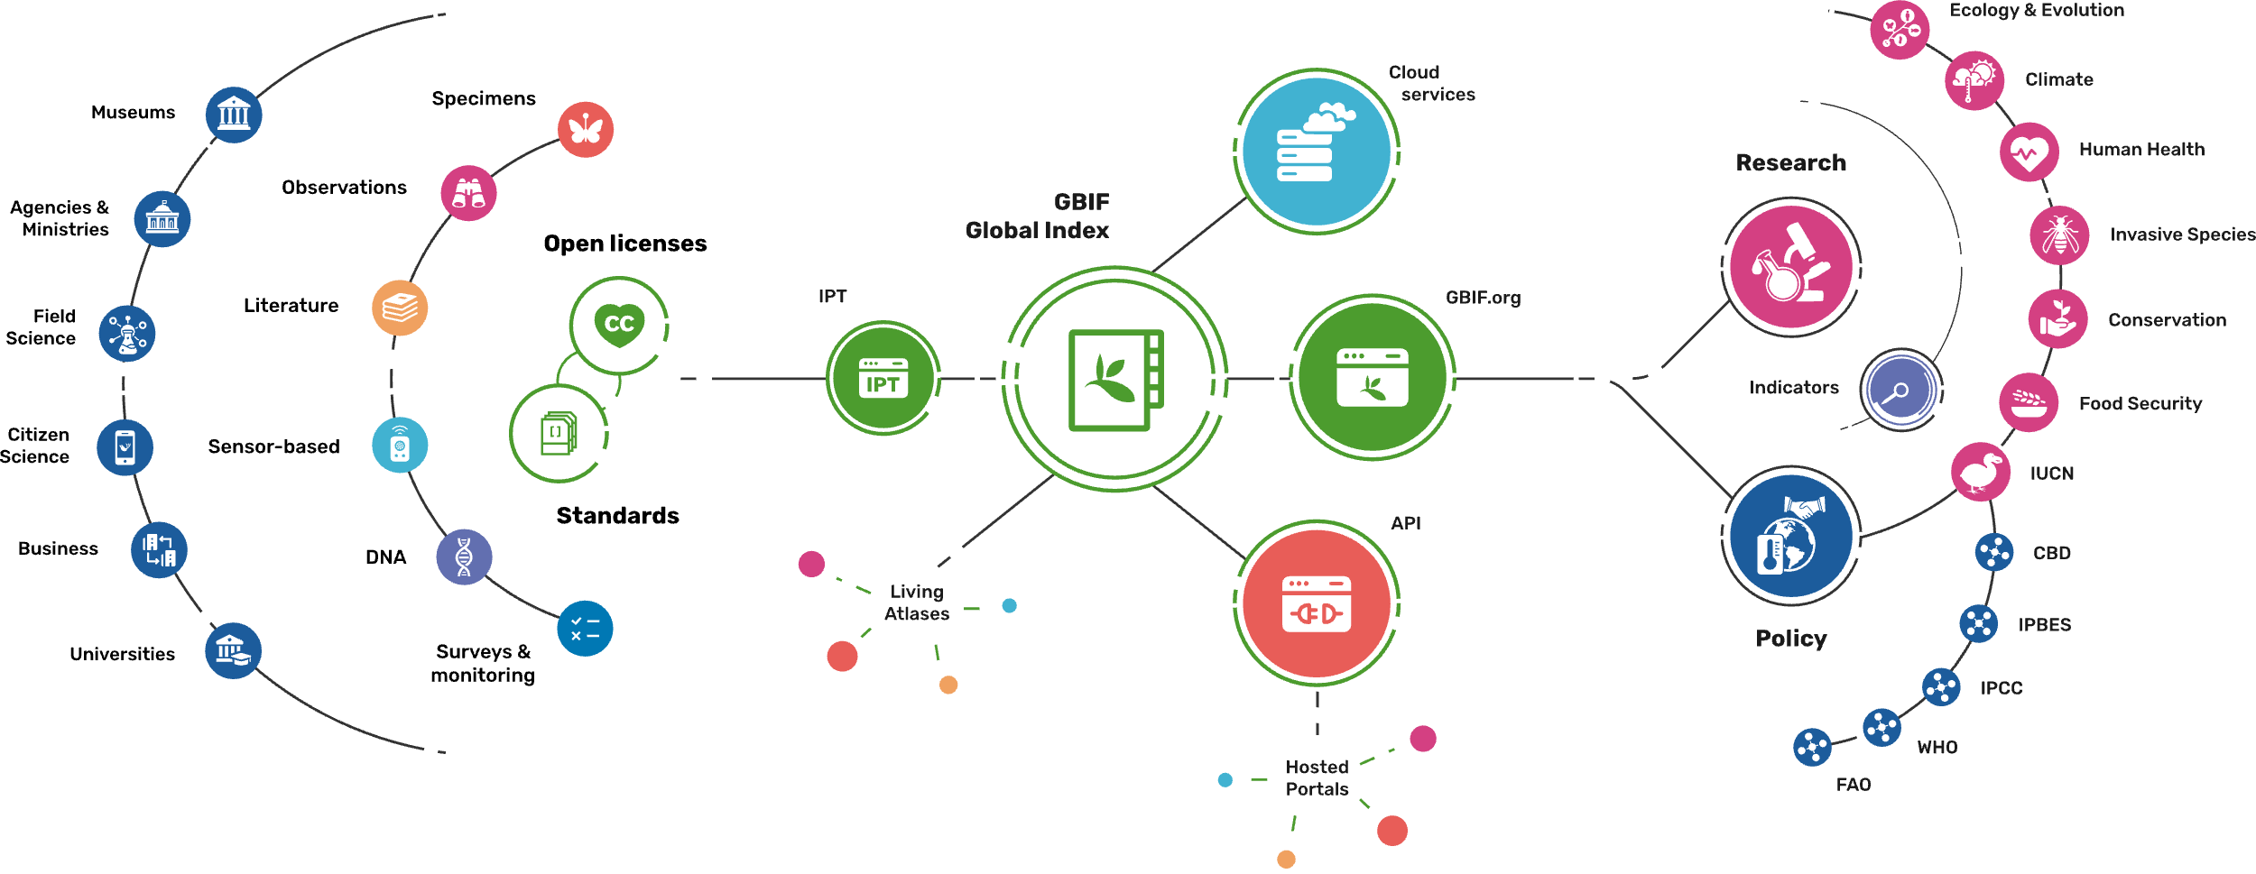
Providing biodiversity evidence for research and policy

Slide 13
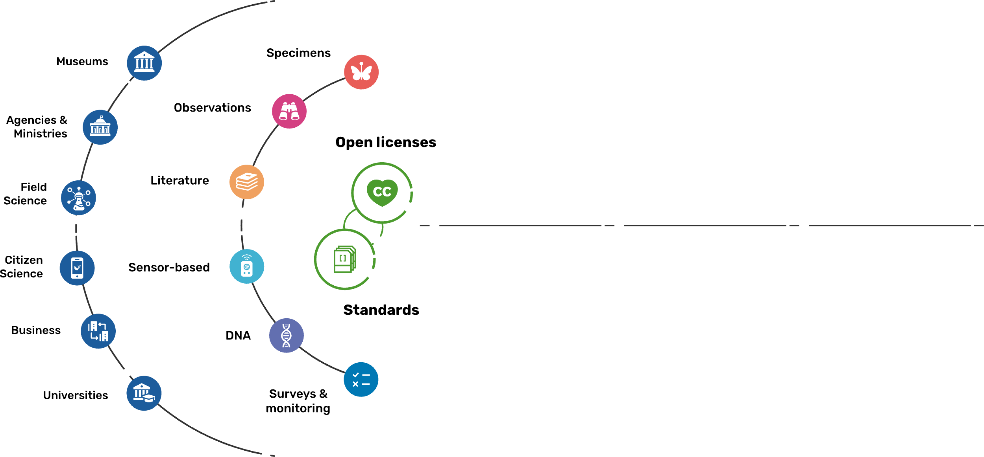
Sources of biodiversity evidence
Create
Combine sources of evidence

Slide 14
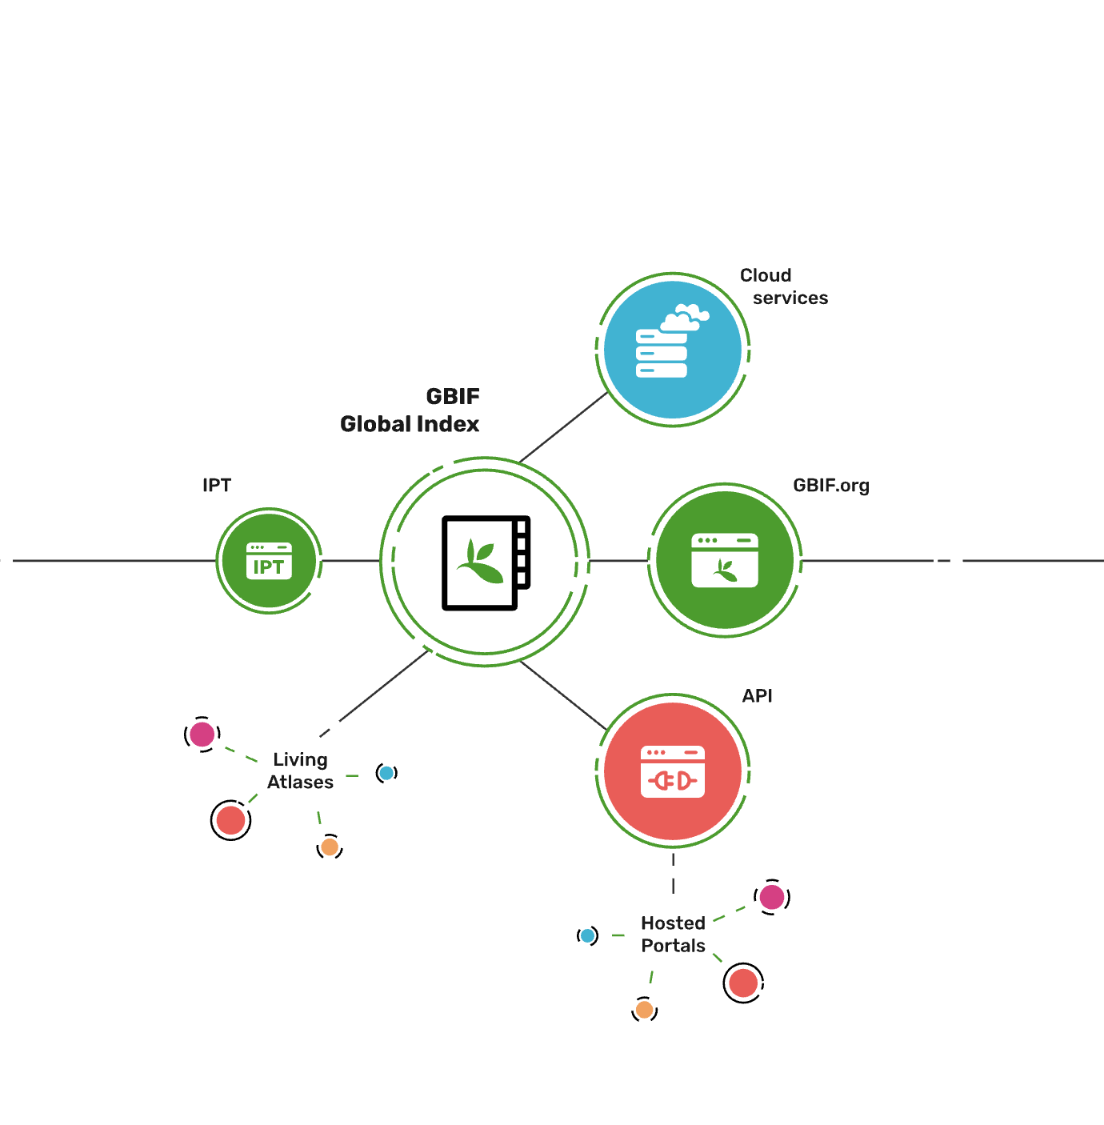
Access to biodiversity evidence
Share
FAIR and open access

Slide 15
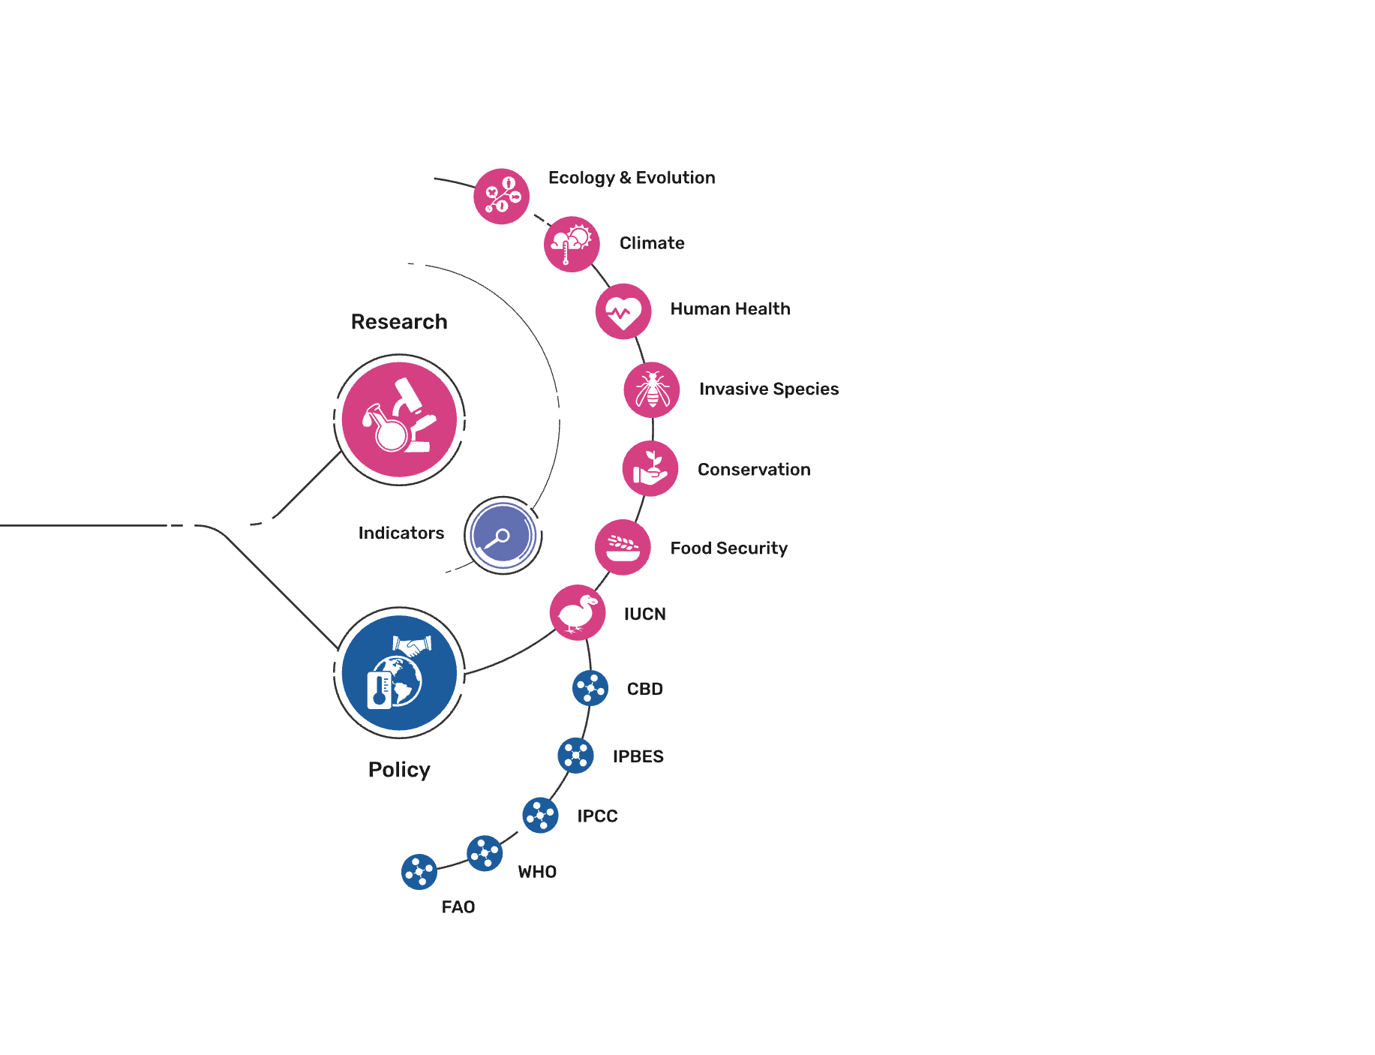
Uses of biodiversity evidence
Transform
Apply and use data

